Slide 1
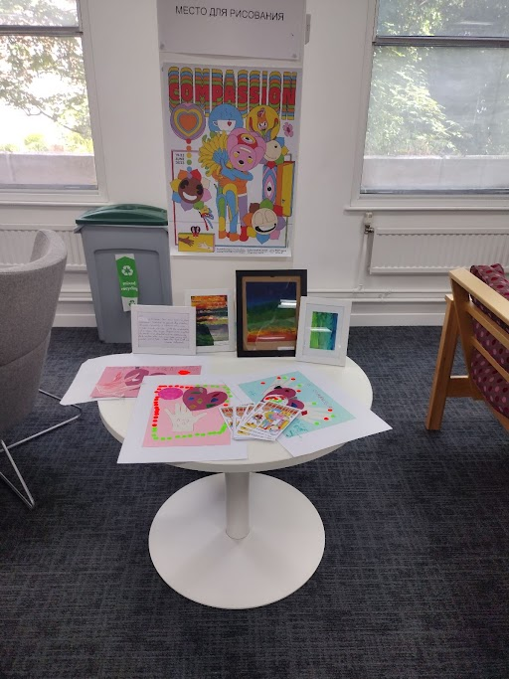
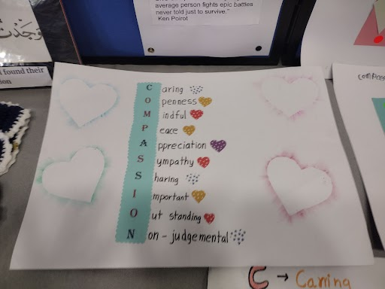
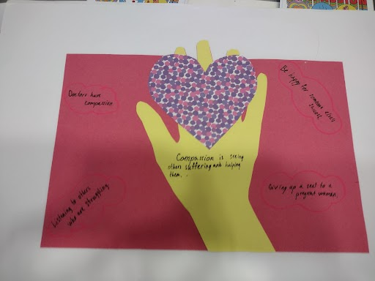
Theme: Compassion
Drawings by adults/children from the Resettlement Schemes, Refugee Action Kingston clients and Ukraine guests during Refugee Week (19th-25th June 2023)
Voluntary Sector Forum 22/11/2023
Shakib Rahman - National Graduate Trainee &Nighat Taimuri - Refugee & Migrant Integration & Resettlement Principal

Slide 2
Overview of Presentation
Sanctuary of Borough accreditation
Overview of City of Sanctuary criteria
Journey to date
Seeking endorsement from the voluntary sector work in partnership with the council
Policy approach (initial steps towards becoming a Borough of Sanctuary)
Partnership policy/strategy (contributions on chapters from VCOs)
VCOs consulted on CoS Policy
VCO has its own Borough of Sanctuary policy/strategy
Ashley Beckett - Voluntary Sector Lead at City of Sanctuary
Notes:
Should it be a policy?

Slide 3
What is the City of Sanctuary (CoS)
The City of Sanctuary began as a local campaign initiative in Sheffield
in 2005 to provide support, dignity, and welcome to refugees and people seeking sanctuary.
Evolved into a charity supporting a network of groups across the UK and Ireland
We are part of the Local Authority Network
Kingston has a long history of welcome and inclusiveness since mid 2005 and are working towards getting Council of Sanctuary accreditation
The principles of Cities of Sanctuary that all networks should adhere to
1
Offer a positive vision of a culture of welcome and hospitality to all
2
Create opportunities for relationships of friendship and solidarity between local people and those seeking sanctuary
3
Recognise and encourage partnership working and network development across localities
4
Identify opportunities for practical action and work on common cause issues to effect change within and across communities (turning empathy into action)
5
Celebrate and promote the welcome & contribution of people seeking sanctuary
6
Engage people seeking sanctuary in decision making processes at all levels and in all activities promote understanding of asylum and refugee issues, especially by enabling refugee voices to be heard directly
Notes:
City of Sanctuary is a charity supporting a network of groups across the UK and Ireland
Other networks include, schools and universities.
working to build a culture of welcome and hospitality within their communities.
Network of groups can be schools, colleges, universities, health care, this one is the local authority network
Although this welcome spreads to anyone who may need it, this movement mainly looks at the inclusion of asylum seekers and refugees
Communicate a positive vision of welcome by promoting the counter narrative to negative rhetoric and celebrating the contribution of people seeking sanctuary;
Integration is a 2 way process
Create opportunities for relationships of friendship and solidarity between people living in receiving communities and people seeking sanctuary; getting that 2 way integration
Working with key partners:Facilitate partnership working and network development across places of sanctuary and support collaboration on common cause issues.
Setting priorities with partners and finding opportunities for projects
Identify opportunities for practical action. First step toward empathy is being willing to pay attention to the suffering those seeking sanctuary face.Turning empathy into action
Celebrate and promote welcome Participating in refugee week - to challenge negative stereotypes
The contributions they can make to the borough’s economy and communities
Recognise the skills and assets they can bring with them and
6. Decision making: Work with people seeking sanctuary, ensuring that they are not just active participants but are empowered to be part of decision-making processes at all levels and in all activities;
Promote understanding of asylum and refugee issues, especially by enabling the voices of people seeking to be heard directly;

Slide 4
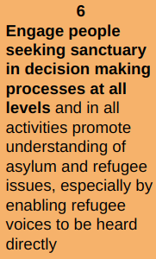
INITIAL STEPS towards the Council of Sanctuary Awards Criteria
The City of Sanctuary award is to recognise and celebrate organisations who go above and beyond people seeking sanctuary
Pass a council motion setting out commitment to being a place of sanctuary
Kingston set out a goal to become a City of Sanctuary at the December 2022 Full Council Meeting MOTION
Join the City of Sanctuary Local Authority Network which includes a pledge to support the vision of City of Sanctuary and an endorsement of its charter
Formally joined the City of Sanctuary (CoS) Network in 2023 and began our journey to recognition as a Borough Council of Sanctuary
Show evidence of the work with local network of groups (receive the endorsement from those groups for the award application)
Commit to work with partners to identify national policy issues in order to make collective representations to government to encourage and enable change
Channel through the Resettlement Board, London Councils, Greater London Authority
Produce a written policy/strategy (either an independent strategy or as part of a broader strategy e.g. equality, migration etc) which is publicly available and sets out commitment for at least three years (Policy in progress)

Slide 5
SPECIFIC STEPS towards the Council of Sanctuary Awards Criteria
The ‘Learn, Embed and Share’ criteria: Provide evidence of meeting each of the criteria
Learn:
find out what it means to be seeking sanctuary; and be actively involved in awareness raising.
Embed:
take positive action to make welcome and inclusion part of the values of your organisation or community, to support people who are seeking asylum and people who are refugees, and to include them in your activities.
Share
Share your vision and achievements: let others know about the positive contribution of people seeking sanctuary make to our society and the benefits of a welcoming culture to everyone.
The process is underpinned by CoS values and broader principles, as outlined in the City of Sanctuary Charter.

Slide 6
Learn criteria : find out what it means to be seeking sanctuary; and be actively
involved in awareness raising.
Working with front line practitioners to understand barriers and
Issues faced by their clients
Criterion 1: Awareness raising opportunities are provided, and opportunities for discussion around the theme of welcome and sanctuary are facilitated.
Employment and Volunteering sub group:
Partners: RAK, Migrant Advocacy Service, Groundwork, Adult Education, DWP, Kingston Hospital and RBK Skills & Employment Coordinator. Working with front line practitioners to understand barriers and Issues faced by their clients
Delivered 4 Fairs with 1110 residents attending with over 265+ confirmed job outcomes - many migrants have attended because RBK arranged interpreters and have supported employers to engage directly with migrants. Delivered a Hong Kong Business Fair Sat 14th Oct which had 115 attend.(Cameron King/RBK)
BAME Mental Health Partnership
Partners: ICope, Refugee Action Kingston, Islamic Resource Centre, Learn English at Home, Nanoom (Korean) Tamil Centre, KAE, Milaap, Kingston Chinese Association, Connect North Korea. Translations of resources, volunteers undertaking Mental Health First Aid Training
ESOL & Communication
Set up an ESOL & Communication (running since 2010 )group to work in a strategic (consisting of statutory and non statutory ESOL providers) and coordinated to bring about best outcomes for refugees. VCOs feed in clients feedback
Developed an ESOL & Communication Leaflet for clients
Bid to Children and Young People Fund (DLHUC) to support children, parents and teachers navigate education system
Next steps
Invite individuals with lived experiences on these groups (voices are heard)
Develop training on refugee and asylum on our learning portal for staff
Criterion 2: refugee/asylum/migration awareness raising is included into everyday business of the local authority e.g. staff induction/training.
Criterion 3: Commitment to supporting the voices of people seeking sanctuary to be heard

Slide 7
Refugee Sports day with RBK
Provision of a RBK staff led sports day in the summer for refugees and their families allowed staff to meet and hear from refugee families and were present when the support of extra food and clothing support was provided by the charity RAK. This allowed us to learn about the families in Kingston who were seeking sanctuary, what was important to them and how they manage with integration into the borough.
Working with Refugee Action Kingston we have learned that many seeking sanctuary are not financially secure and so access to activities that may improve health and wellbeing are not always available to them. There are also language barriers for some seeking sanctuary and the inclusion of translation specialists being available at RBK is helpful when delivering services.

Slide 8
Embed Criteria
take positive action to make welcome and inclusion part of the values of your organisation or community, to support people who are seeking asylum and people
who are refugees, and to include them in your activities
Criterion 4: The local authority must demonstrate how it has embedded the concept of welcome and inclusion at all levels of the organisation
Volunteering contract is focusing on supporting refugees as a priority cohort in 2023/24 - Refugees are a priority group within the EQIA process so should be specifically considered
Targeted corporate commissioned services for refugees, vulnerable migrants and ESOL learners
Launch of the Council’s Resettlement Board in June 2023
Resettlement /Integration Schemes using Home Office Indicators for Integration Framework
Syrian Vulnerable Persons Resettlement Scheme now UK Resettlement Scheme
Afghan Assistance Relocation Policy
Afghan Citizens Relocation Scheme
Hong Kong BNOs
Kingston United for Ukraine
Welcome space at GH2 accessible for other refugee and migrant groups
Criterion 5: Commitment to supporting initiatives that embeds welcome and fosters solidarity between receiving communities and people seeking sanctuary
Notes:
Refugee action kingston since 2008
leah since 2016
MAS since 2023
Syrian 51 individuals
34 afghans resettled ARAP
ACRS 1 family of 6
Hong kong bnos over 1000 - data from school admissions
KUU - x households
Integration support at GH for Ukraines, refugees and migrants

Slide 9
Share Criteria: Share your vision and achievements: let others know
about the positive contribution of people seeking sanctuary make to
our society and the benefits of a welcoming culture to everyone.
Refugee Week June 2023 was celebrated in Kingston with a dedicated display at Guildhall 2, displaying artwork on the theme of Compassion from clients from Refugee Action Kingston, Kingston United from Ukraine and families and the Vulnerable Persons Resettlement Scheme.
Raising of the City of Sanctuary Flag on 20th June 2023. This was attended by Councillors, Leader of the Council and The Chief Executive. There was representation from the Voluntary Sector
Criterion 6: A public commitment to the City of Sanctuary vision of Welcome (motion)
Criterion 7: The local authority publicly highlights its work in support of welcome and inclusion
Criterion 8: Commitment to ongoing engagement with the City of Sanctuary Local Authority Network
Criterion 9: Work with the network to identify national policy issues in order to make collective representations to government to encourage and enable change
Notes:
Stll need to work on policy issues with the GLA/ and the Home office

Slide 10
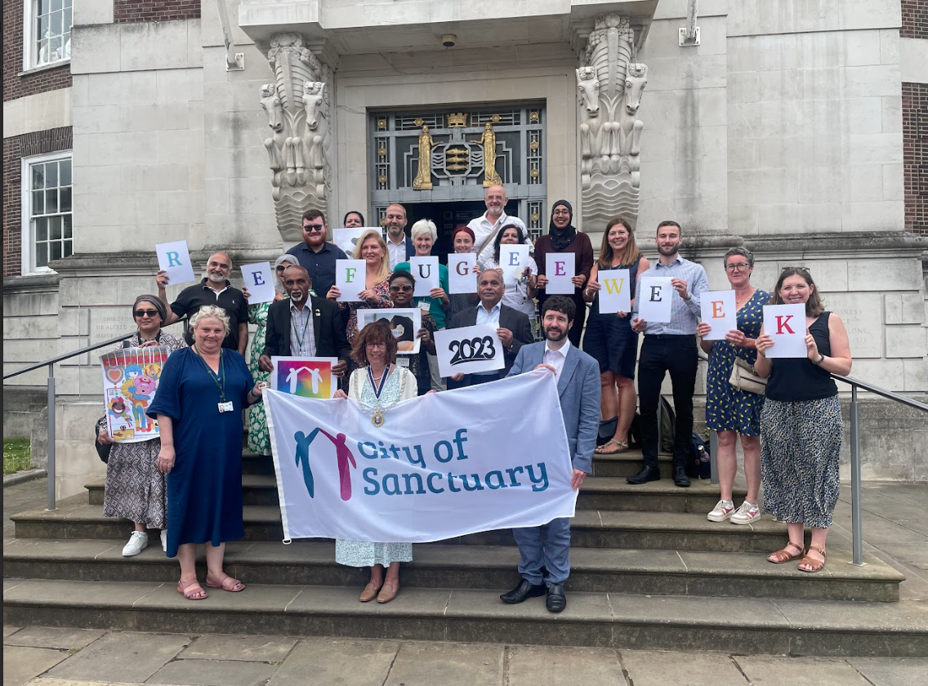
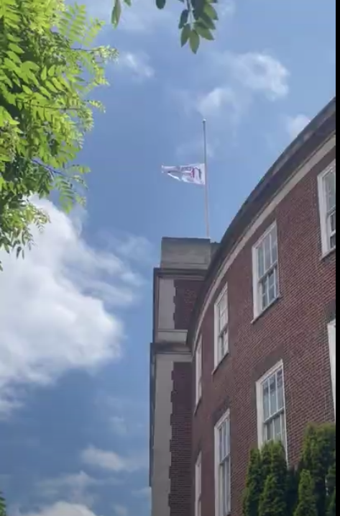
Raising the City of Sanctuary Flag on 20th June 2023 during Refugee Week (19th-25th June)

Slide 11
ASSESSMENT & AWARD
Sanctuary Award Application will be appraised by a Sanctuary Recognition panel which will normally include as a minimum:
a local member of City of Sanctuary,
someone who has lived experience of seeking sanctuary and
a member of the City of Sanctuary Local Authority Steering Group.
The panel may request a visit to the nominated organisation during the appraisal,
London awarded boroughs: Lewisham and Lambeth. Islington and Waltham Forest being assessed next week.

Slide 12
City of Sanctuary Support
Maggie - supports the council
Ashley - Supports the VCOs
How are VCOs involved?
Create Group
Support Forum
Inform on Process

Slide 13
Questions to think about
City of Sanctuary: Partnership strategy?
VCO Own strategy? (Ashley to help)
VCO consultation on strategy
Forum to get lived experience feedback?
Best way to capture good practice to date in VCO (Google form)?

Slide 14
Thank you for your time
ashley@cityofsanctuary.org

